Slide 1

Brain Tumor Classification
Sanjay Jaras
Bellevue University

Slide 2
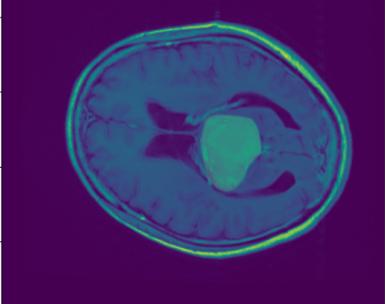
Introduction
What is brain Tumor ?
700000 American living with brain tumors
69.8% benign 30.2% malignant
Estimated 87,240 people in 2020

Slide 3
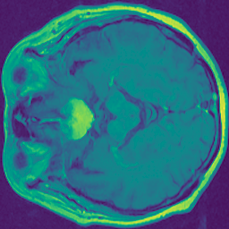
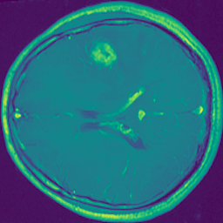
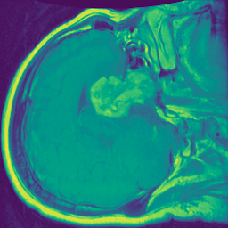
Types of Brain Tumors
Primary
Meningioma
Glioma
Pituitary
Secondary

Slide 4
Proposed model
Medical Imaging
X-Ray
CT-Scan
MRI
Convolution Neural Net

Slide 5
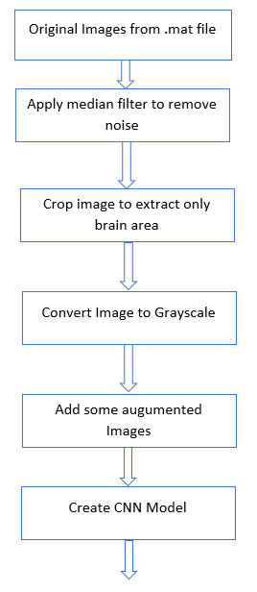
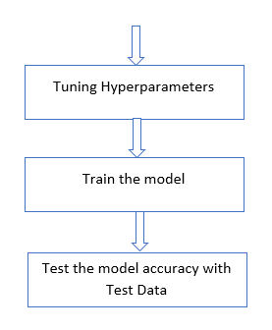
Proposed Approach

Slide 6
Dataset
Source: figshare: https://figshare.com/articles/brain_tumor_dataset/1512427
3064 images
708 Meningioma images,
1426 Glioma images,
930 pituitary tumor images
233 patients
.mat files Structure
label: 1 for meningioma, 2 for glioma, 3 for pituitary tumor
PID: patient ID
image: image data
tumorBorder: a vector storing the coordinates of discrete points on the tumor border.
tumorMask: a binary image with 1s indicating tumor region

Slide 7
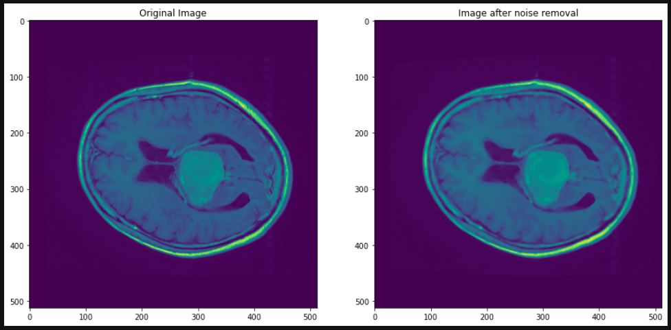
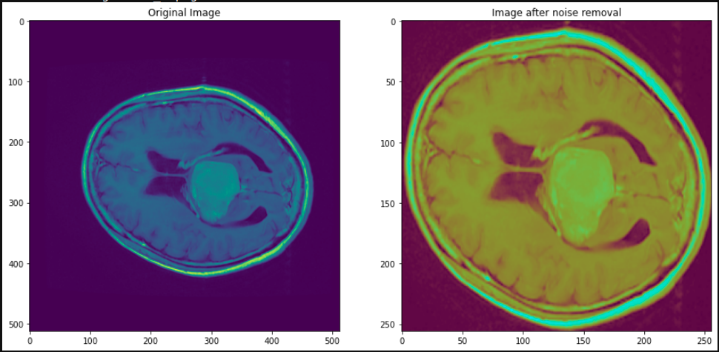
Image Preprocessing
Read .mat files h5py
Image
Label
Reduce noise in images
Median filter from scipy.ndimage
Crop the image
https://www.pyimagesearch.com/2016/04/11/finding-extreme-points-in-contours-with-opencv/

Slide 8
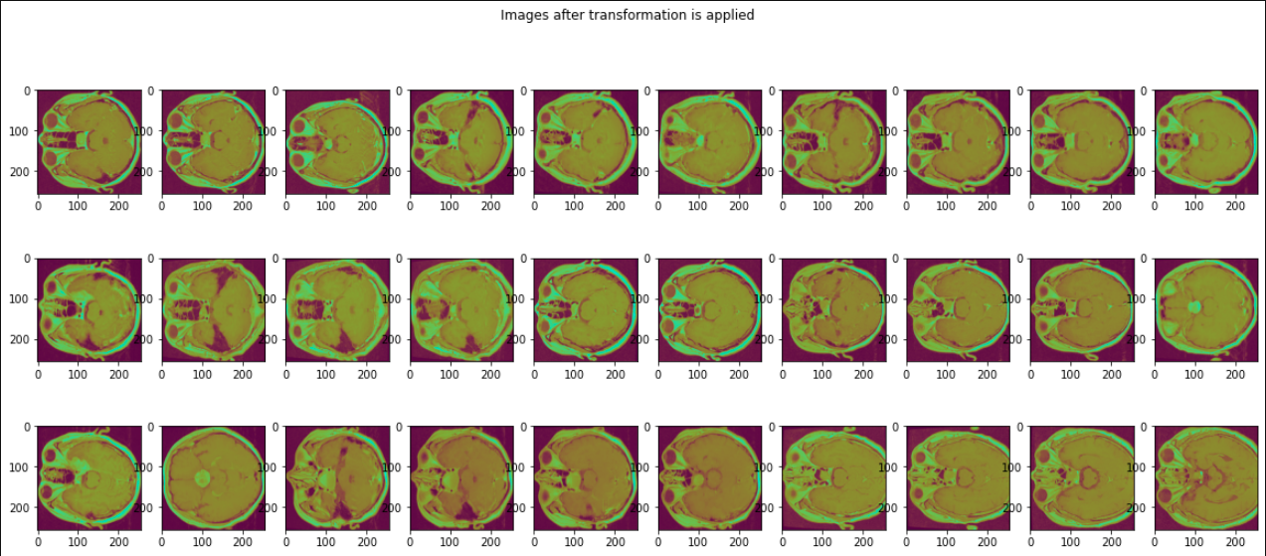
Image Preprocessing
Convert to Grayscale
Save Images

Slide 9
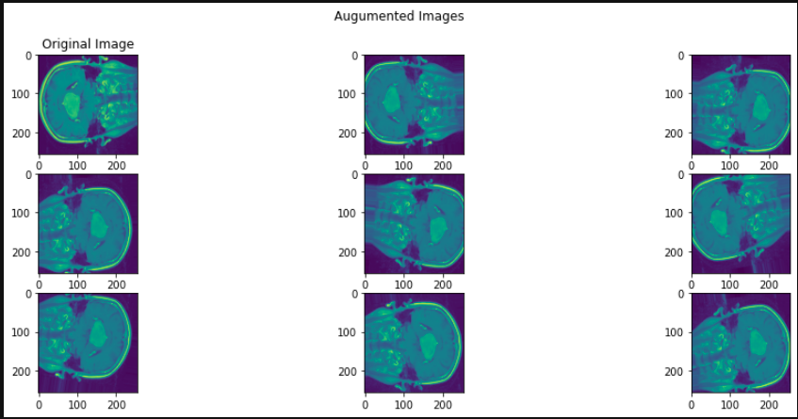
Load data
Images
Labels
One-hot encoding
Load augmented Images
Reshape data to vectors
Split the data to training and test datasets

Slide 10
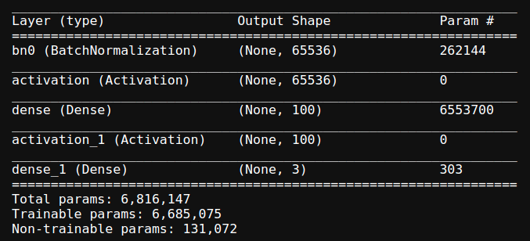
Create Data model
Sequential Keras model

Slide 11
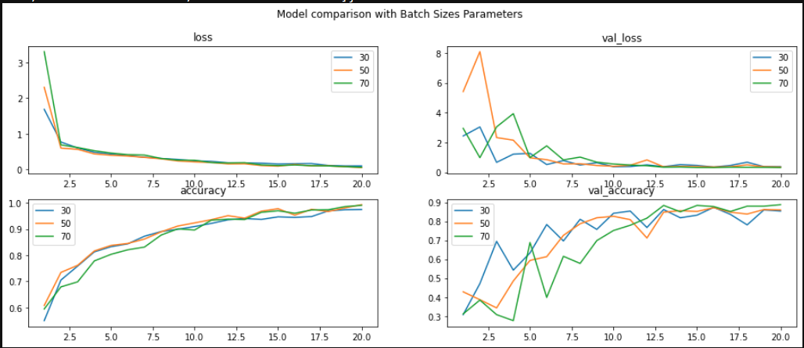
Hyperparameter Tuning
Batch Size
30
50
70

Slide 12
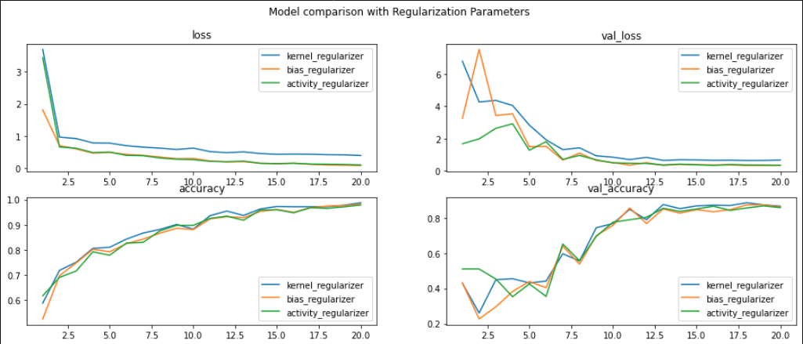
Hyperparameter Tuning
Layer weight Regularizers
kernel_regularizer: l1=1e-5 and l2=1e-4 bias_regularizer: l2 = 1e-4 activity_regularizer: l2=1e-5

Slide 13
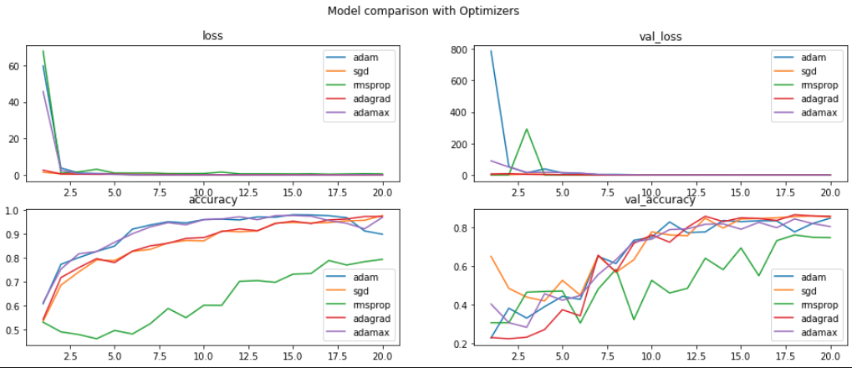
Hyperparameter Tuning
Optimizers
Adam
SGD
Rmsprop
Adagrad
Adamax

Slide 14
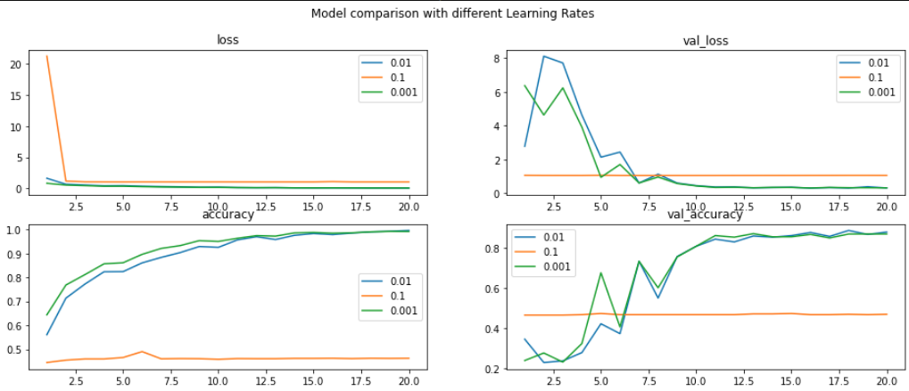
Hyperparameter Tuning
Learning Rate
0.1
0.01
0.001

Slide 15
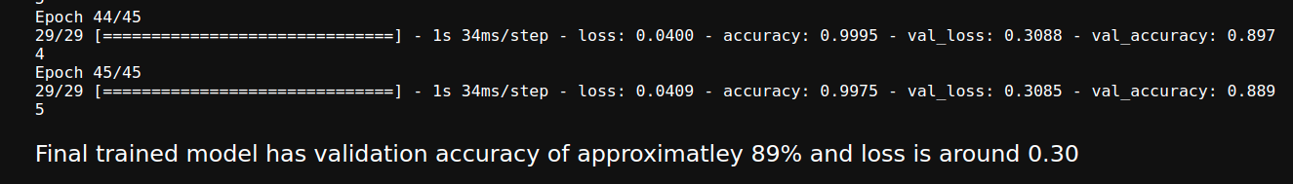
Train the model
Optimizer: Adagrad,
bias regularizer: l2=1e-4,
learning rate:0.001
batch size as 70.

Slide 16
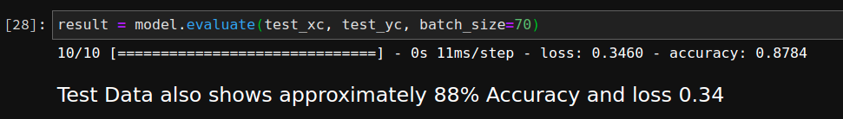
Test the model
20% Test Dataset

Slide 17
Thank You!

